Slide 1
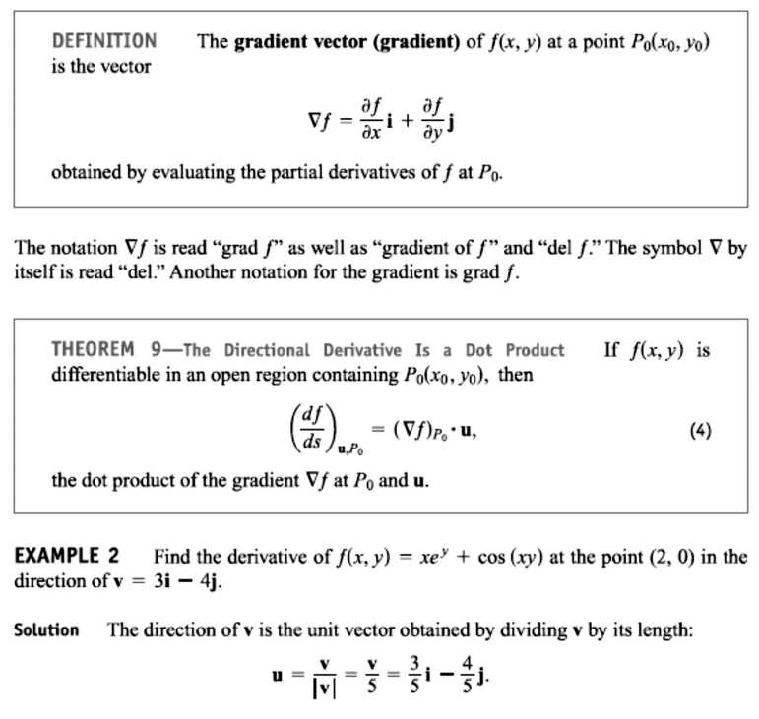
15 / Dep. Of Engineering Mechanics
th
Class: 2 AMTHMATICS / T he Partial Derivatives

Slide 2
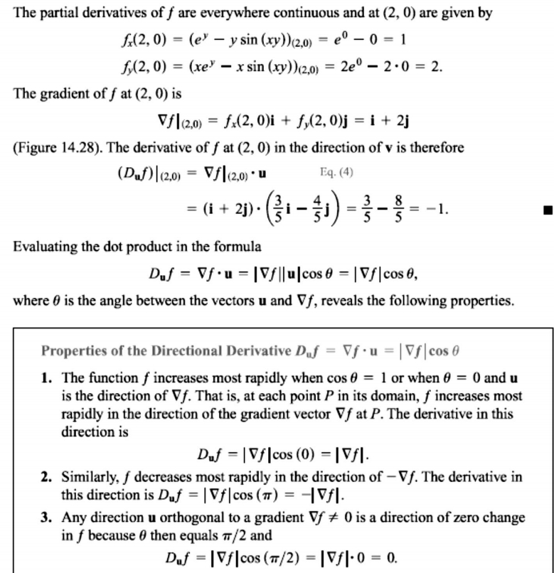
16 / Dep. Of Engineering Mechanics
th
Class: 2 AMTHMATICS / T he Partial Derivatives

Slide 3
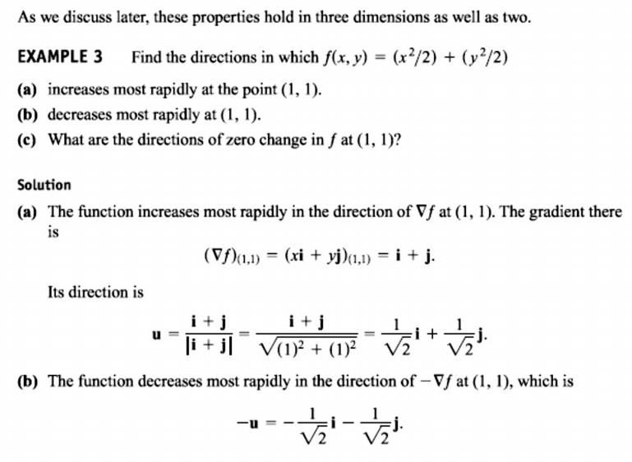
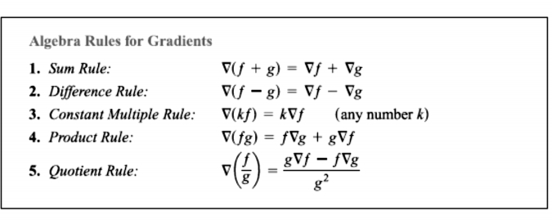
17 / Dep. Of Engineering Mechanics
th
Class: 2 AMTHMATICS / T he Partial Derivatives

Slide 4
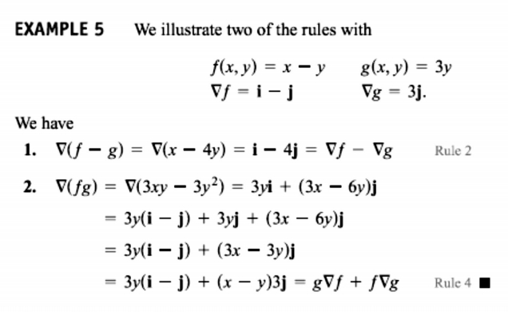
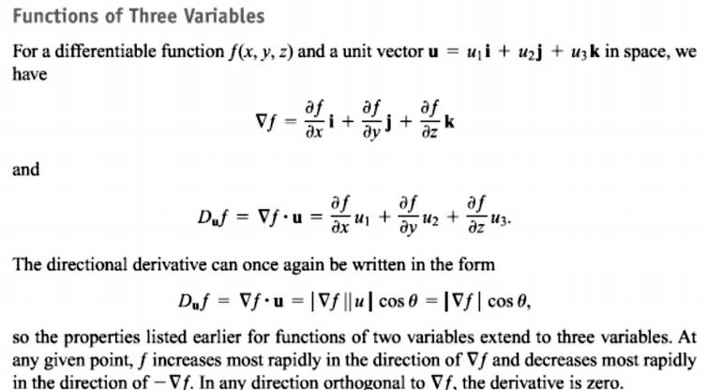
18 / Dep. Of Engineering Mechanics
th
Class: 2 AMTHMATICS / T he Partial Derivatives

Slide 5
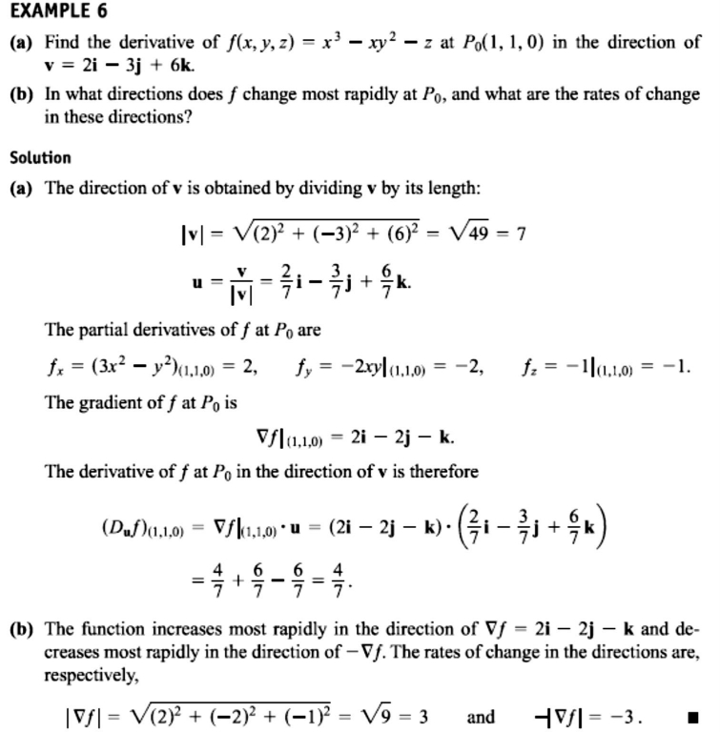
19 / Dep. Of Engineering Mechanics
th
Class: 2 AMTHMATICS / T he Partial Derivatives

Slide 6
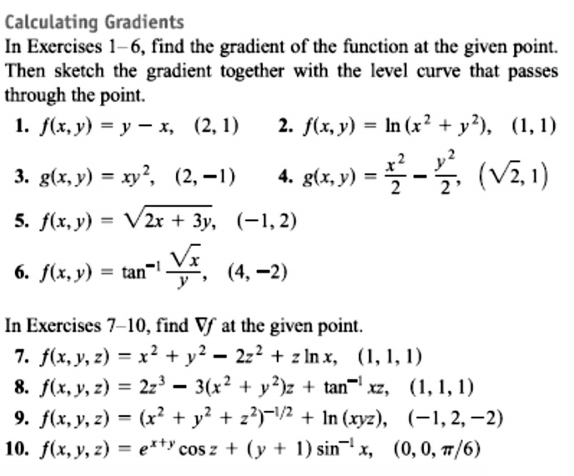
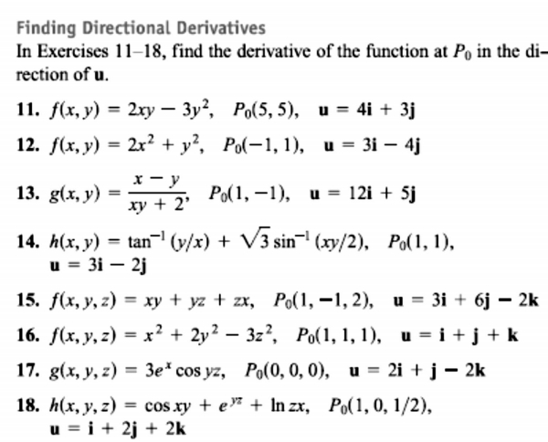
20 / Dep. Of Engineering Mechanics
th
Class: 2 AMTHMATICS / T he Partial Derivatives

Slide 7
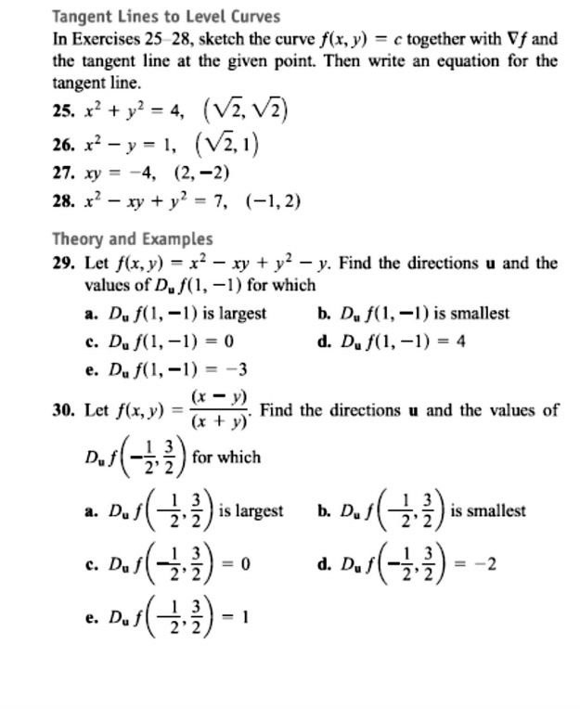
21 / Dep. Of Engineering Mechanics
th
Class: 2 AMTHMATICS / T he Partial Derivatives

